Slide 1
Working with Database
February 15, 2018
Presenter:
Copyright © 2014 by Vikram Takkar. All Rights Reserved..

Slide 2
Working with Database
Extracting data from a database tables.
Joining within the database component.
Joining outside the database component.
Writing data to a database
Database to database transfer (ELT Components)
Dynamic database lookup
How to execute multiple SQL queries through Talend.
How to share same Database connections with Child jobs.
Implementing slowly changing dimensions Type 1 (SCD Type1).
Implementing slowly changing dimensions Type 2 (SCD Type2).
Implementing slowly changing dimensions Type 3 (SCD Type3).
Copyright © 2014 by Vikram Takkar. All Rights Reserved..

Slide 3
Extracting data from a database tables.
Use the repository metadata object for MySQL database “world” and extract data from following tables:
City
Country
countryLanguage
Copyright © 2014 by Vikram Takkar. All Rights Reserved..

Slide 4

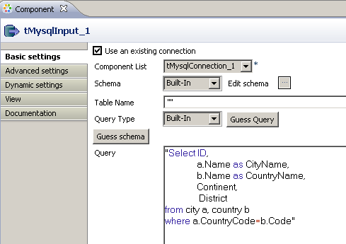
Joining within the database component.
Write SQL Query with in tMysqlInput component to retrieve data.
Select ID,
a.Name as CityName,
b.Name as CountryName,
Continent,
District
from city a, country b
where a.CountryCode=b.Code

Slide 5
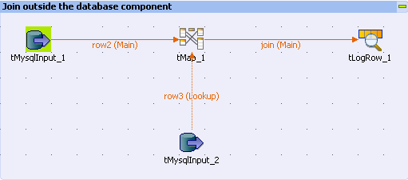
Joining outside the database component.
We can use two tMysqlInput components to join/ look up data. In this scenario, data will be downloaded from database server to staging area/disc and then join will be performed on the Talend server.
Copyright © 2014 by Vikram Takkar. All Rights Reserved..

Slide 6
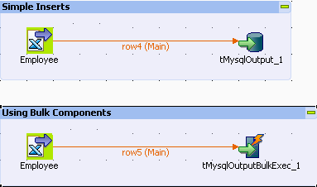
Writing data to a database
We can use tMySQLOutput and tMysqlBulkExec components to load data to database.
Example: Read EMPLOYEE_INPUT1.xlsx file and loads data to database table.

Slide 7
Writing data to a database
Action on Table
On the table defined, you can perform one of the following operations:
Default: No operation is carried out.
Drop and create a table: The table is removed and created again.
Create a table: The table does not exist and gets created.
Create a table if not exists: The table is created if it does not exist.
Drop a table if exists and create: The table is removed if it already exists and created again.
Clear a table: The table content is deleted.
Truncate table: The table content is quickly deleted. However, you will not be able to rollback the operation.

Slide 8
Writing data to a database
Action on Data
On the data of the table defined, you can perform:
Insert: Add new entries to the table. If duplicates are found, the job stops.
Update: Make changes to existing entries.
Insert or update: inserts a new record. If the record with the given reference already exists, an update would be made.
Update or insert: updates the record with the given reference. If the record does not exist, a new record would be inserted.
Delete: Remove entries corresponding to the input flow.
Replace: Add new entries to the table. If an old row in the table has the same value as a new row for a PRIMARY KEY or a UNIQUE index, the old row is deleted before the new row is inserted.
Insert or update on duplicate key or unique index: Add entries if the inserted value does not exist or update entries if the inserted value already exists and there is a risk of violating a unique index or primary key.
Insert Ignore: Add only new rows to prevent duplicate key errors.

Slide 9
Questions?
Copyright © 2014 by Vikram Takkar. All Rights Reserved..

